Slide 1
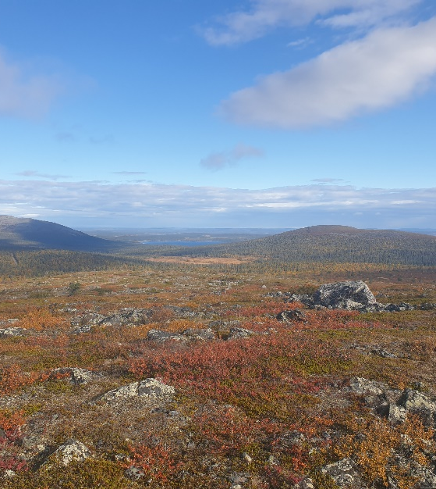
Tenax TA tube results from EMEP intensive measurement period of 2022
Heidi Hellén
Finnish Meteorological Institute

Slide 2
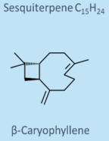
Background
Measurements at 17 sites
C₇-C₁₅ hydrocarbons
Focus on BVOCs: monoterpenes +sesquiterpenes (isoprene)
AVOCs: aromatic hydrocarbons, alkanes, PAHs, (benzene)
 | Lifetime OH (h) | Lifetime O₃ (h)
Isoprene | 2 | 27
Alpha-pinene | 4 | 4
Limonene | 1 | 2
Beta-caryophyllene | 1 | 0.03
Ethane | 758 | -
Benzene | 148 | -
Toluene | 33 | -
1,2,4-trimethylbenzene | 6 | -
[OH]=1.43E+6 molec cm⁻³, [O₃]=36 ppb

Slide 3
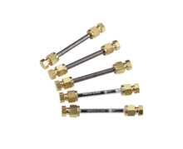
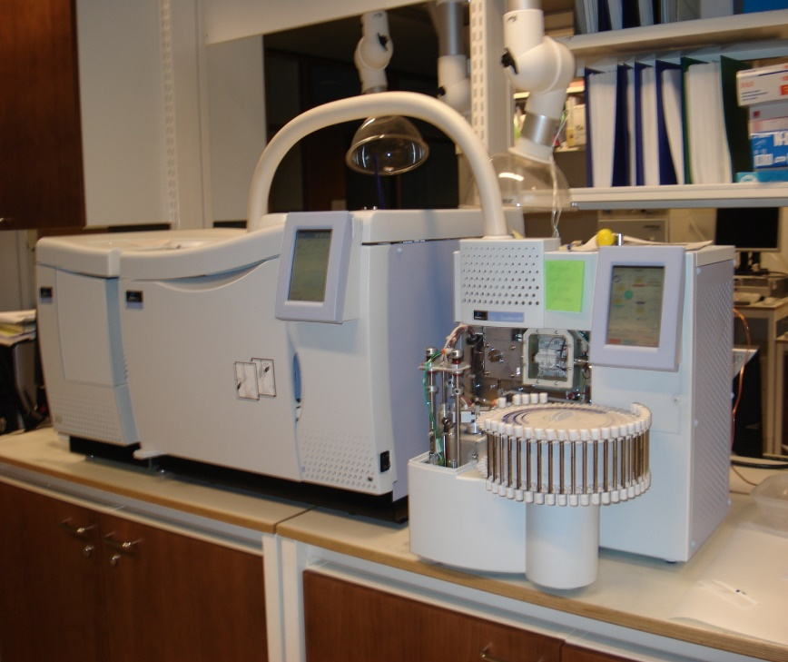
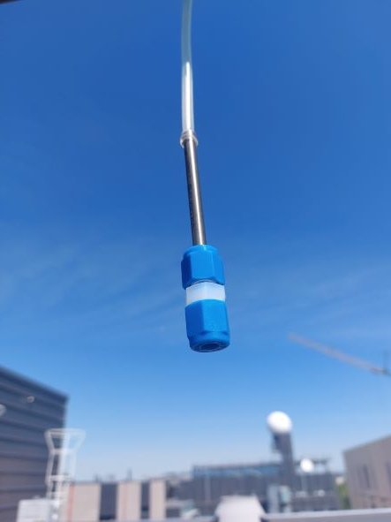
Method
Tenax TA-carbopack B tubes
Ozone trap
(a filter impregnated with sodium thiosulfate)
Analysis with TD-GC-MS
Two hour sampling after midday 12-19/7/2022

Slide 4
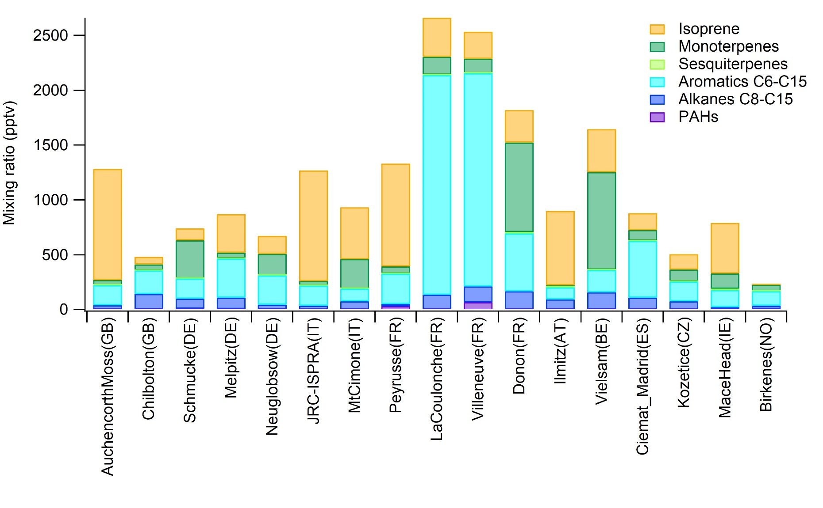
Mean mixing ratios during the campaing 12/7-19/7/2022

Slide 5
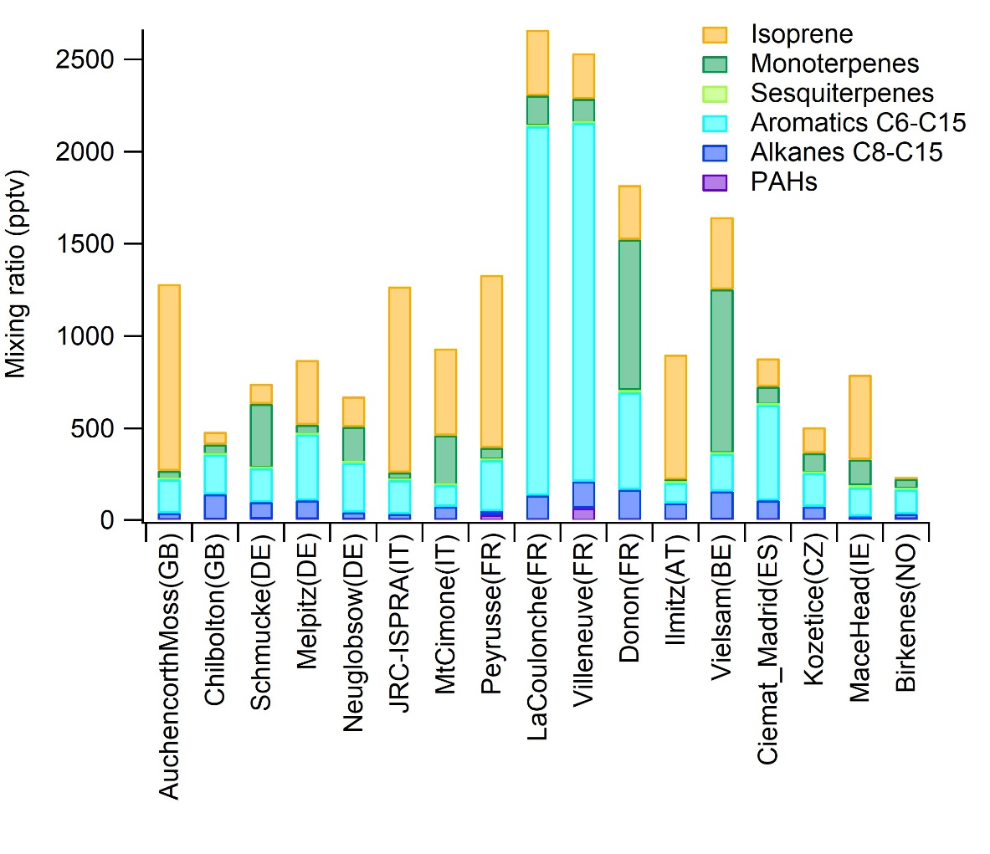
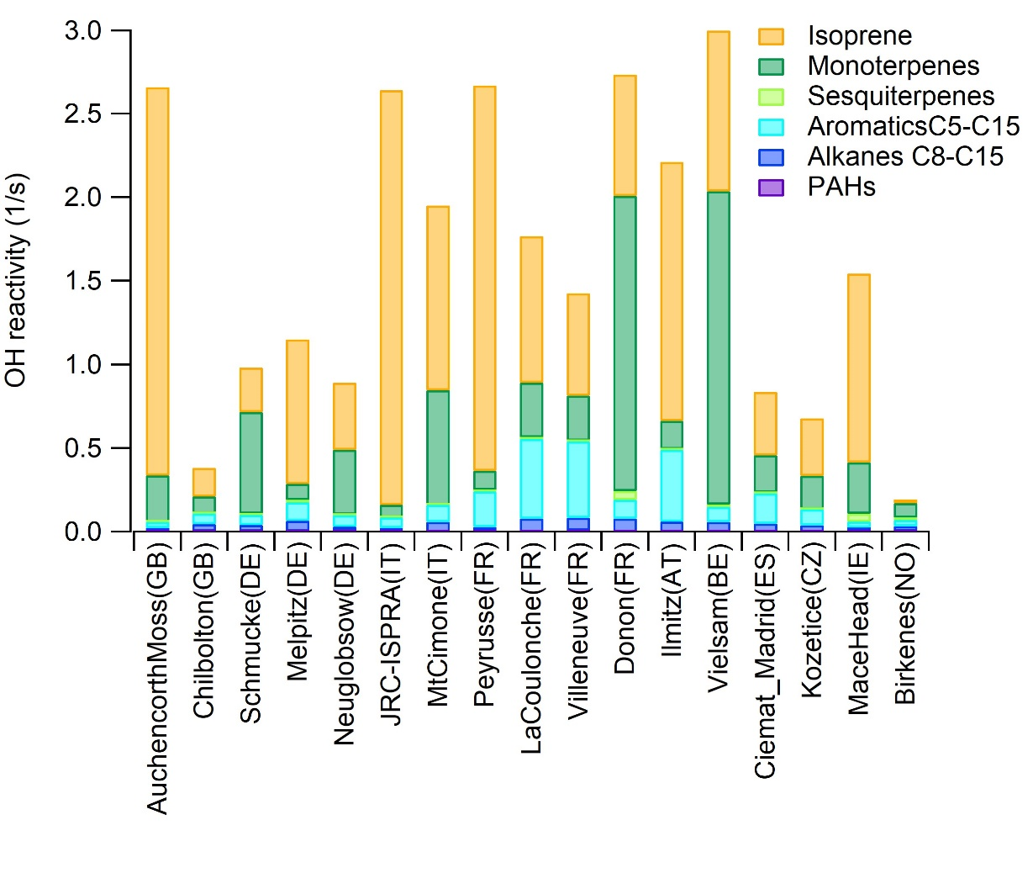
Hydroxyl radical (OH) reactivities (R_{OH})
Mixing ratios
OH reactivities
Total OH reactivity (Tot R_{OH}) is the inverse of OH lifetime
$$R_{OHi}=k_{OHi}\left[i\right]$$

Slide 6
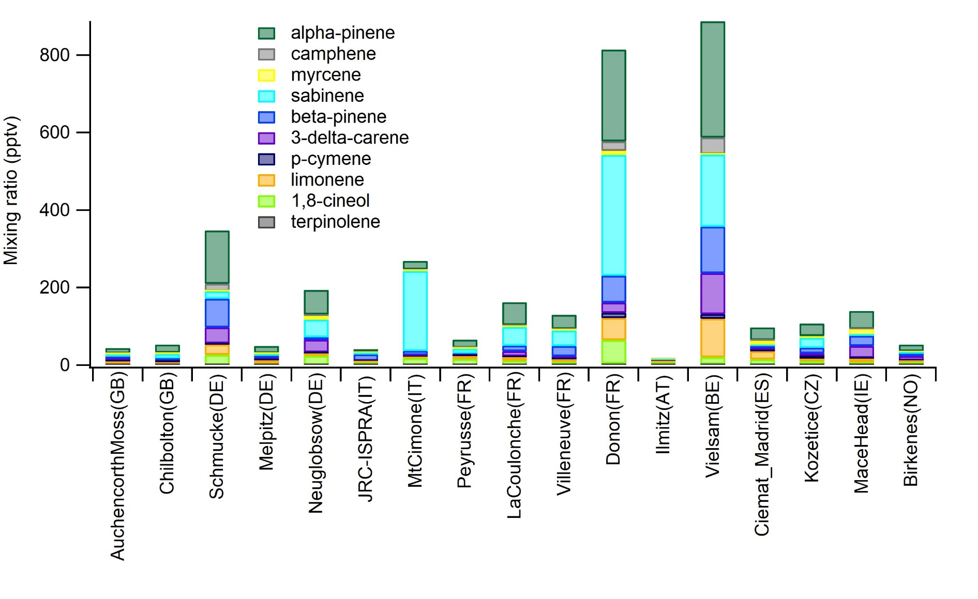
Mean mixing ratios of monoterpenes

Slide 7
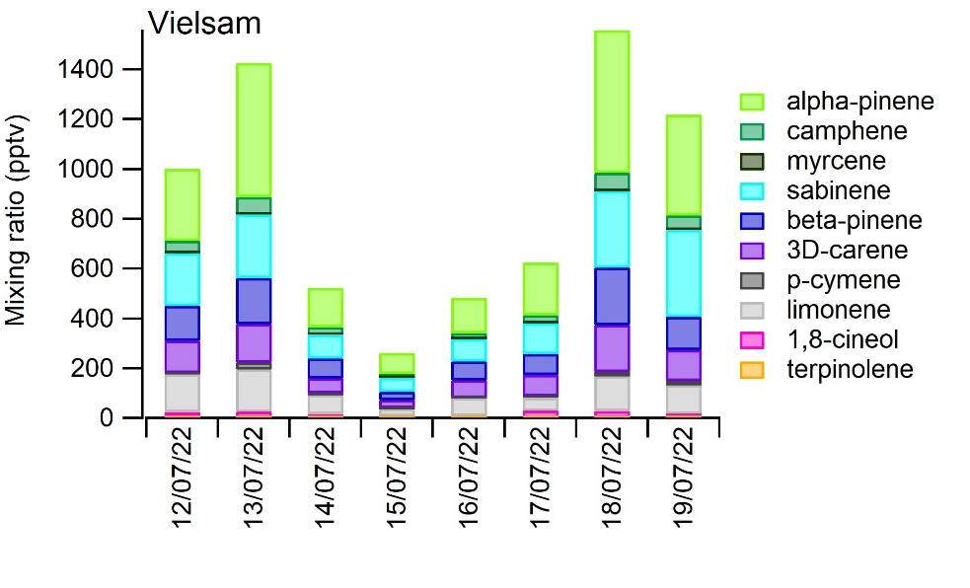
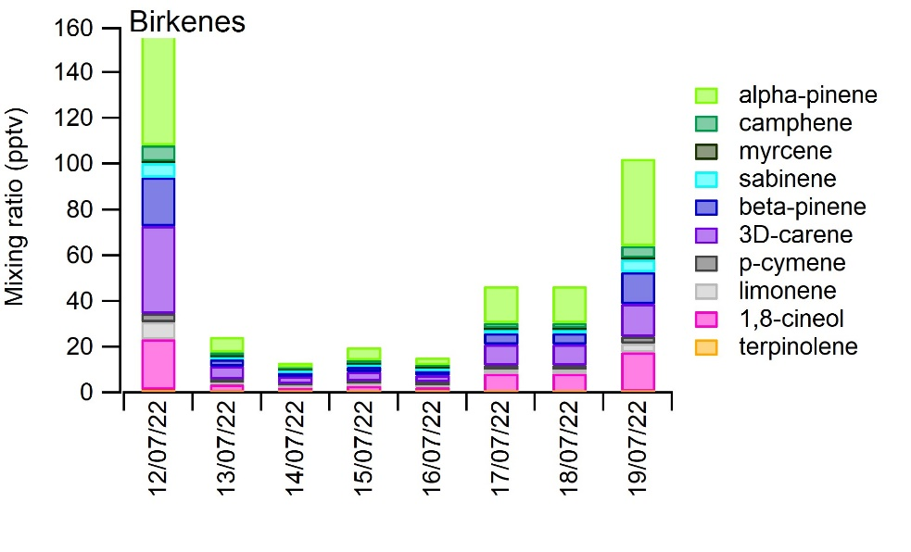
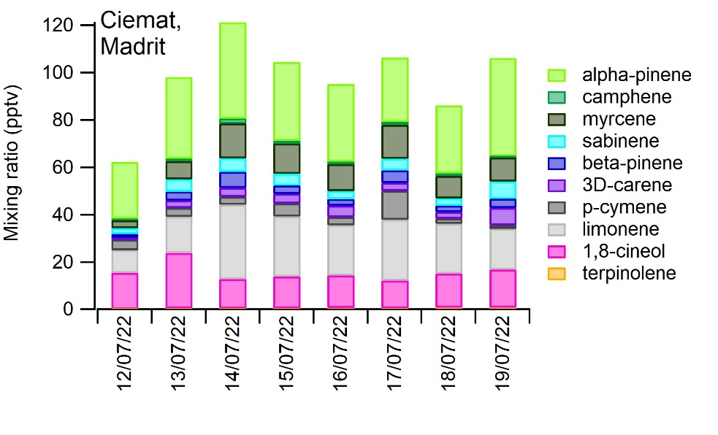
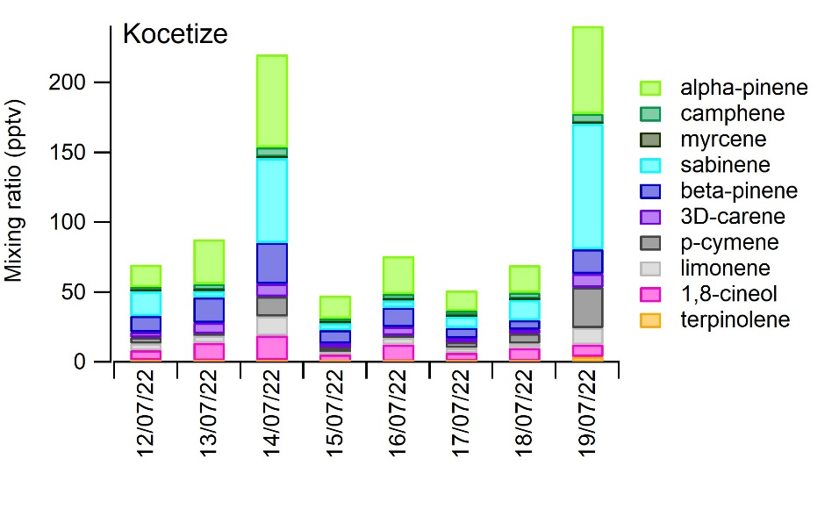
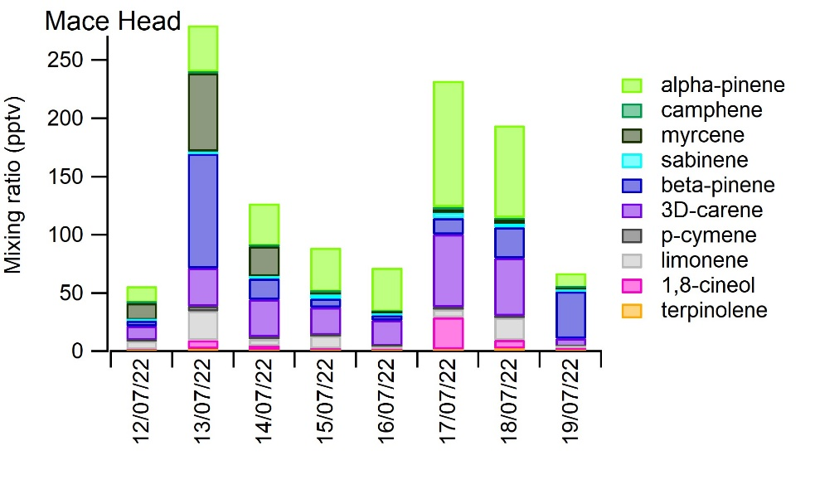
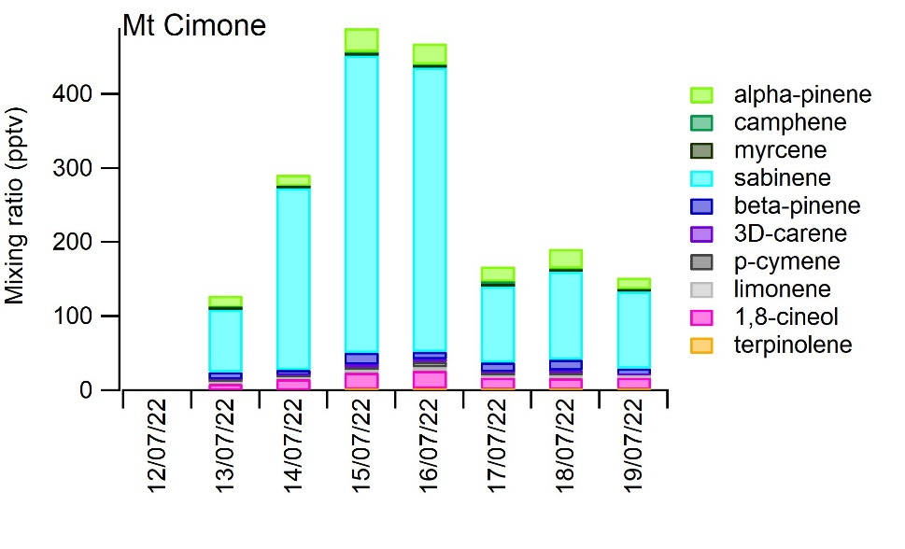
Daily variation of monoterpenes

Slide 8
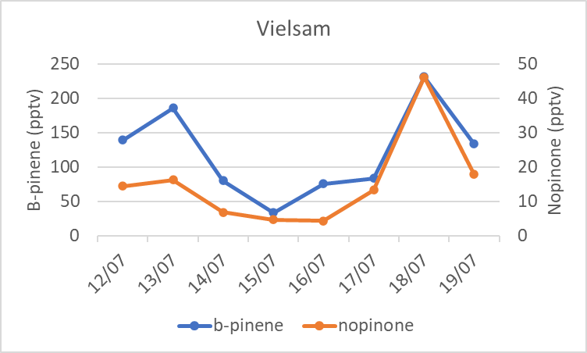
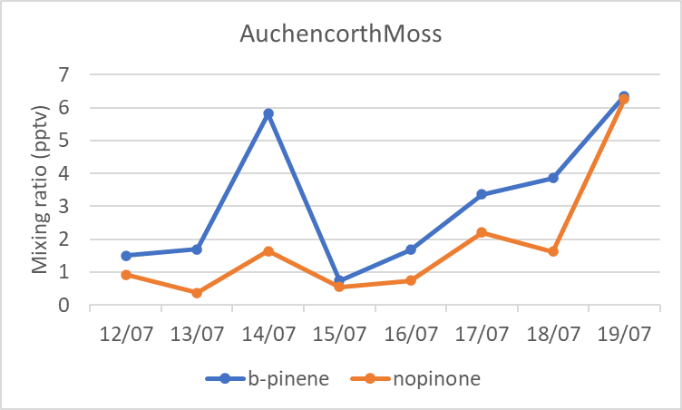
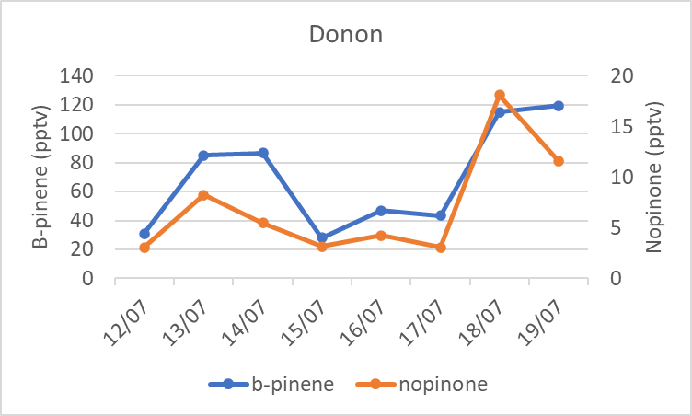
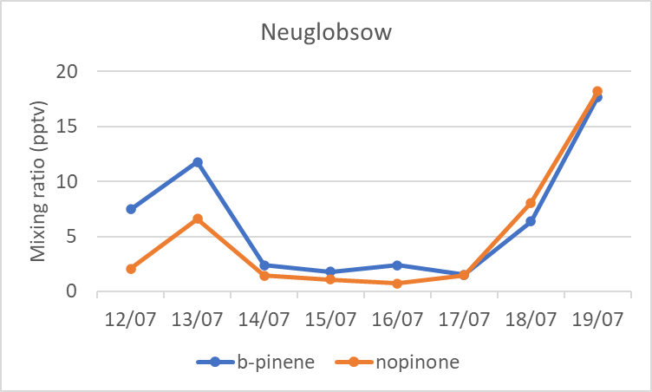
Mixing ratios of beta-pinene and its oxidation product nopinone

Slide 9
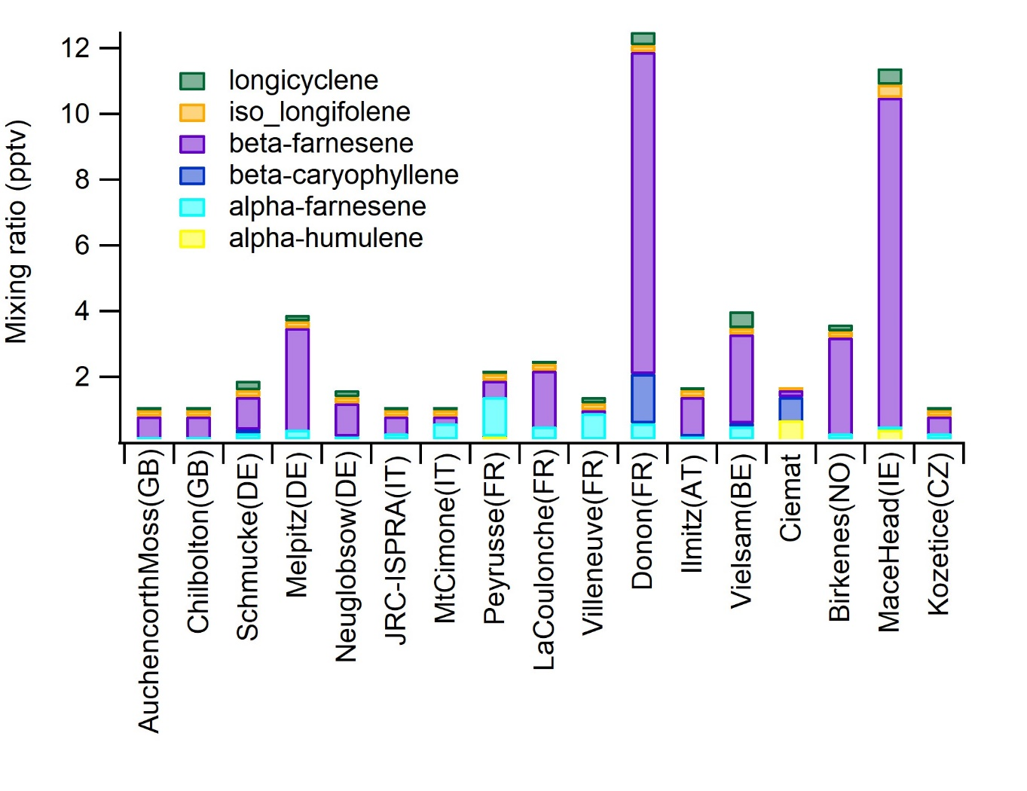
Mean mixing ratios of sesquiterpenes

Slide 10
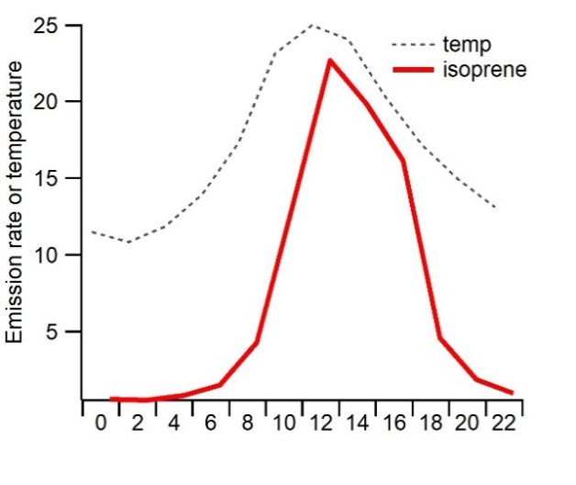
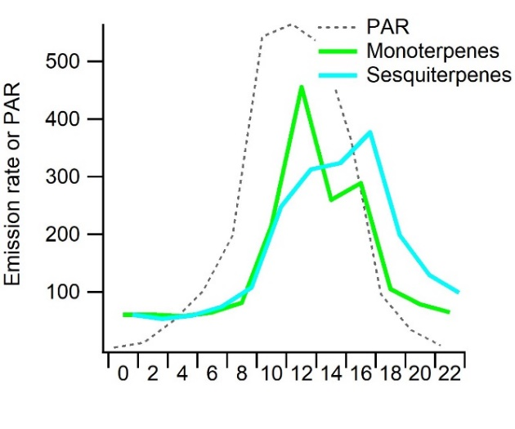
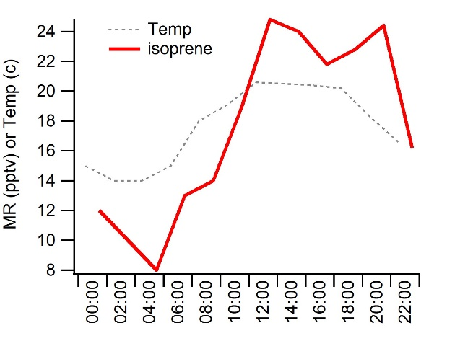
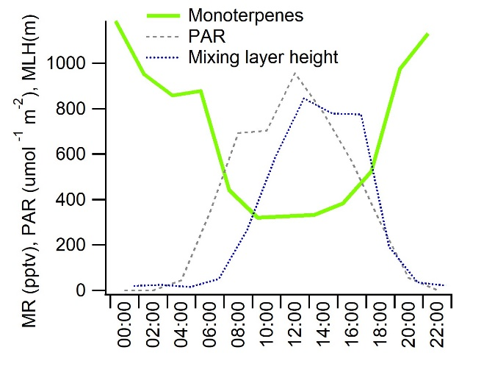
Diurnal variability of biogenic VOCs
Spruce emission at Pallas in 2019 (Hakola et al. 2023)
Isoprene has light dependent emissions -> emitted only during the day
Mono- and sesquiterpenes has both light and temperature dependent emissions -> emitted also during the night
Mixing ratios (MR) at a boreal forest site (Hyytiälä) in July 2016
(Hellén et al. 2018)
Mixing ratios of isoprene highest during the light hours
Not emitted during the dark hours
Lowest mixing ratios of mono- and sesquiterpenes often measured in the afternoon
Mixing has strong impact

Slide 11
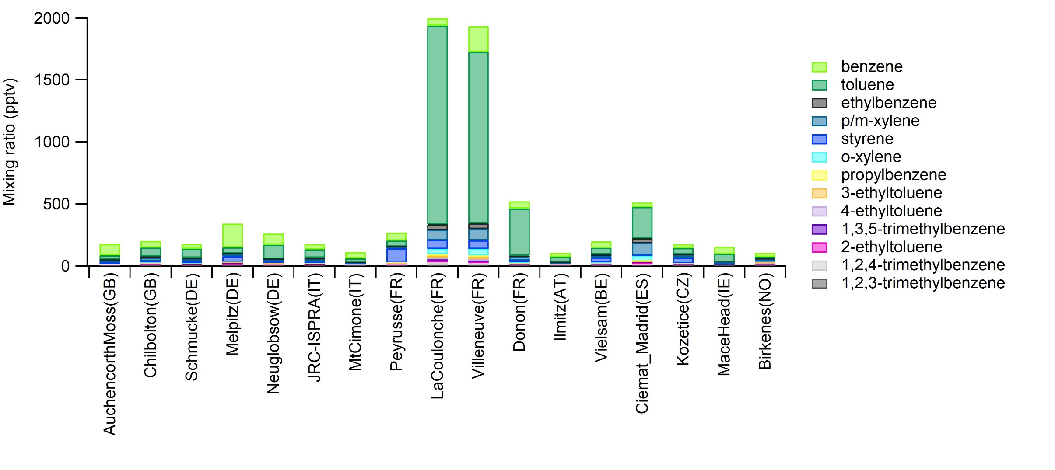
Mean mixing ratios of C₆-C₉ aromatic hydrocarbons

Slide 12
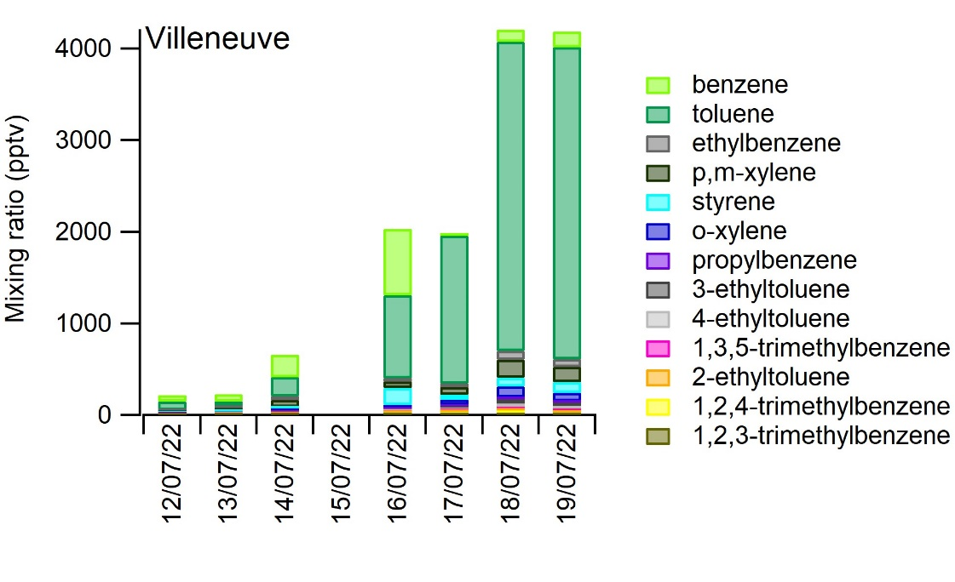
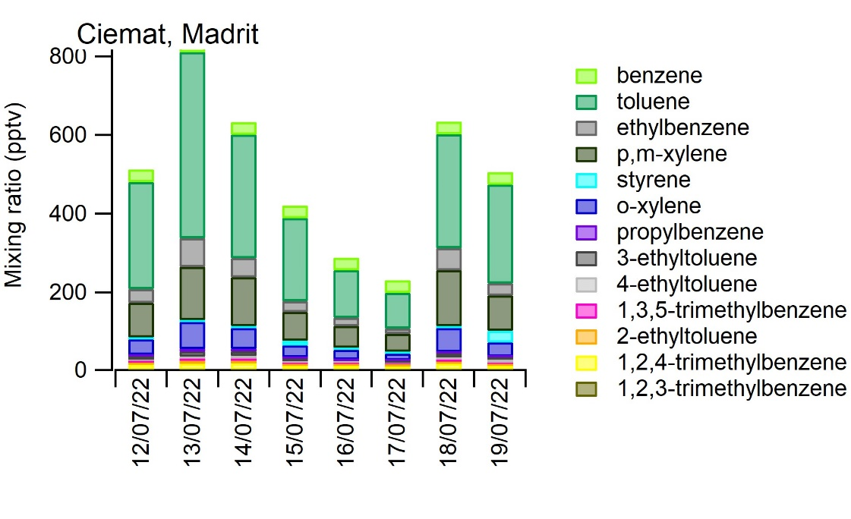
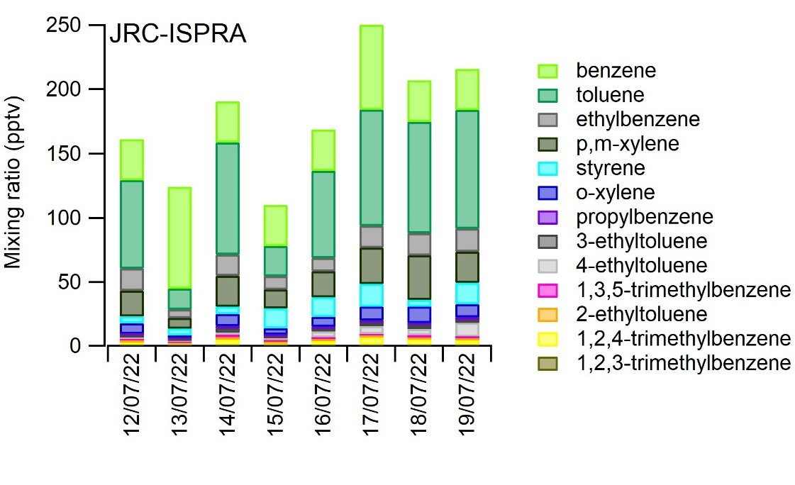
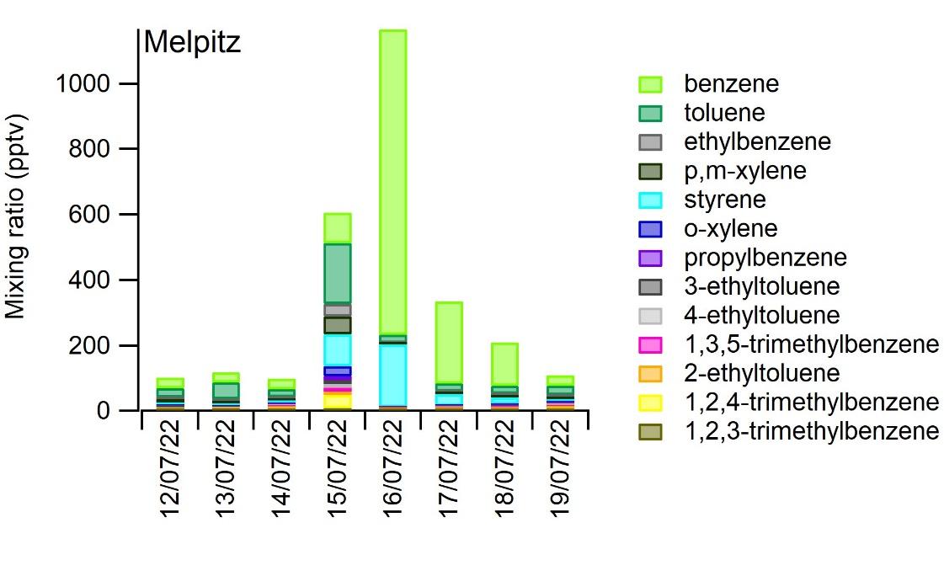
Daily variation of aromatic hydrocarbons

Slide 13
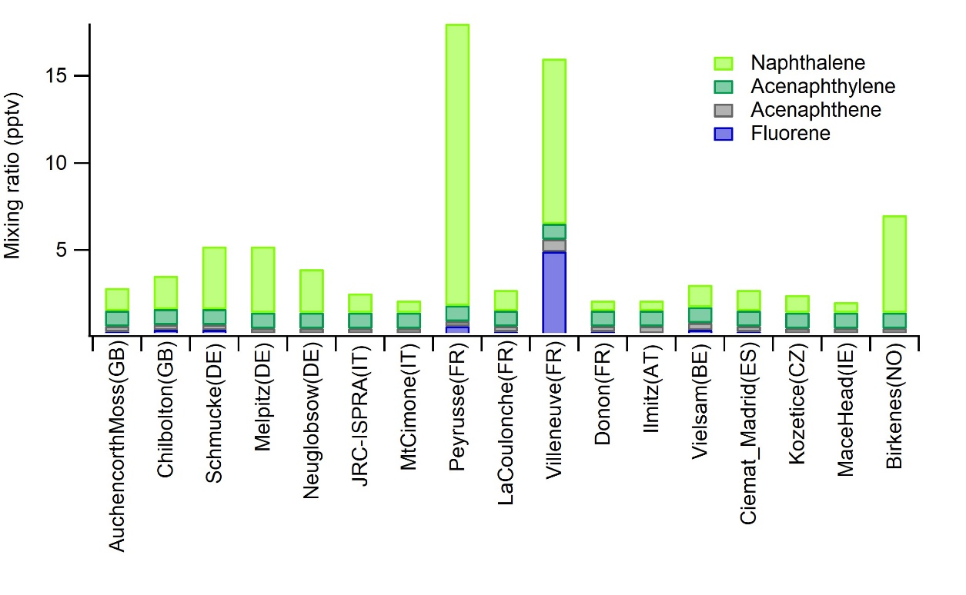
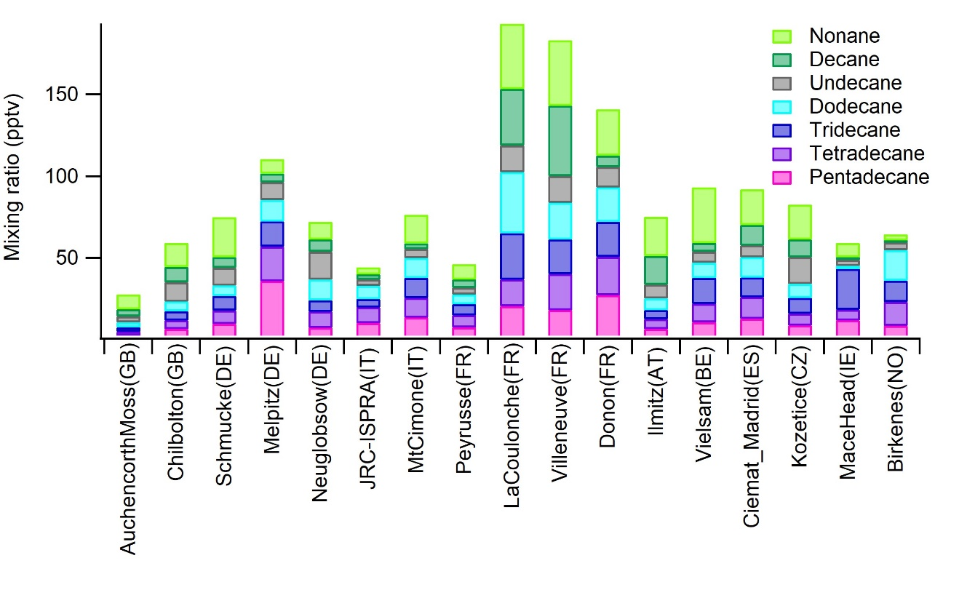
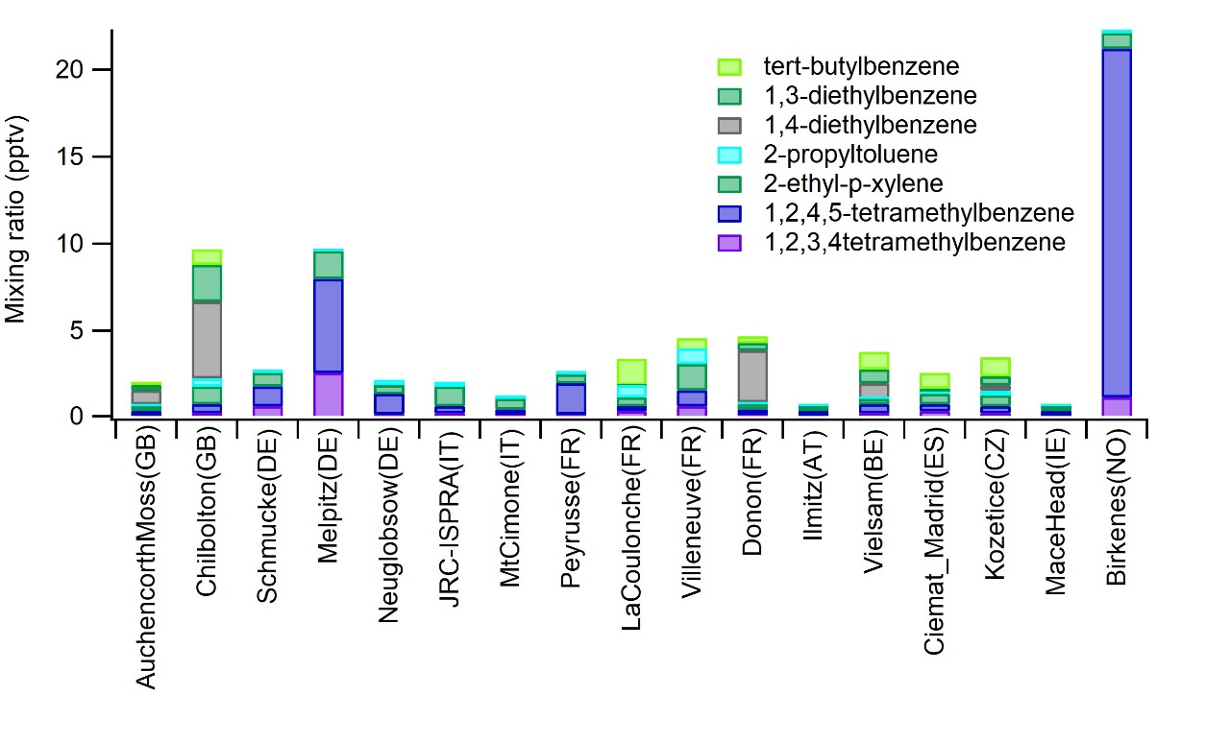
Other measured VOCs
PAHs
C8-C15 alkanes
C₁₀ aromatic HCs

Slide 14
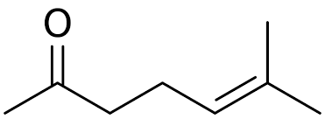
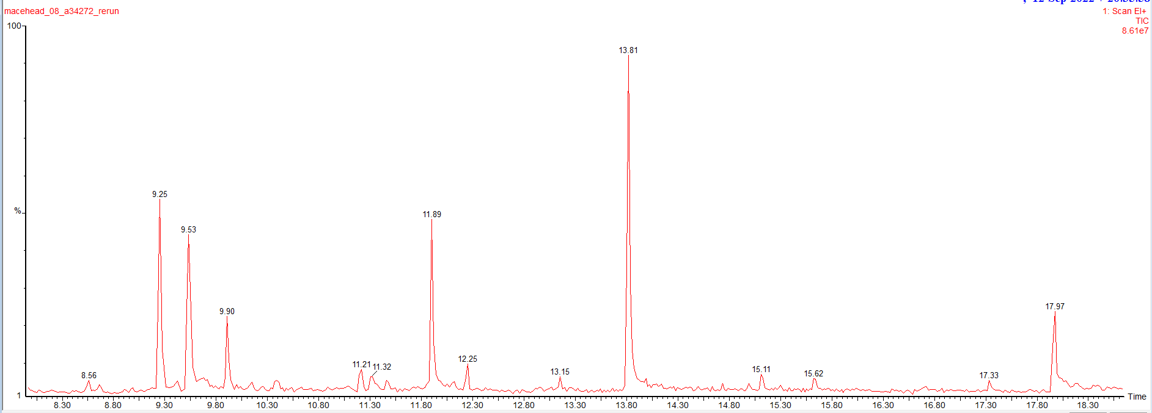
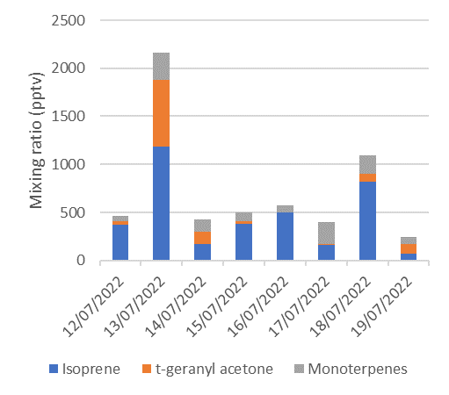
Additional peaks detected in the chromatograms
Trans-geranyl acetone C₁₃H₂₂O
Additional non-quantified site specific compounds may also have sometimes strong contribution
Trans-geranyl acetone, higher aldehydes, 6-methyl-5-heptene-2-one
6-methyl-5-hepten-2-one C₈H₁₄O
Mace Head 19/7/2022
decanal
Mace Head
siloxane
6-methyl-5-heptene-2-one
nonanal
octanal
t-geranyl acetone
undecanal
*t-geranyl acetone quantified as beta-farnesene

Slide 15
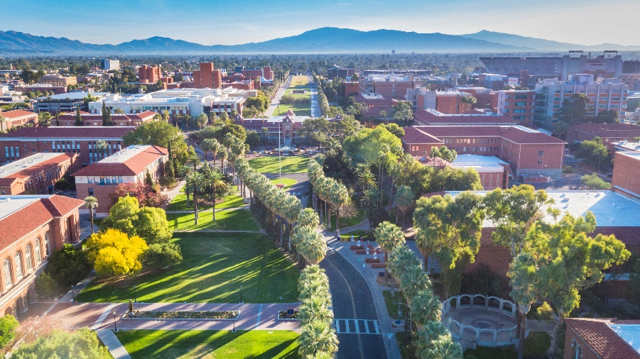
Summary and conclusions
There were strong daily variation of the mixing ratios at most stations
Significant contribution from monoterpenes other than alpha-pinene were detected
Terpene ratios showed high variations between the stations
Additional non-quantified compounds at this volatility range were detected at some sites
Based on the measured concentrations, biogenic VOCs are expected to have major contribution on local chemistry and SOA formation

